Slide 2
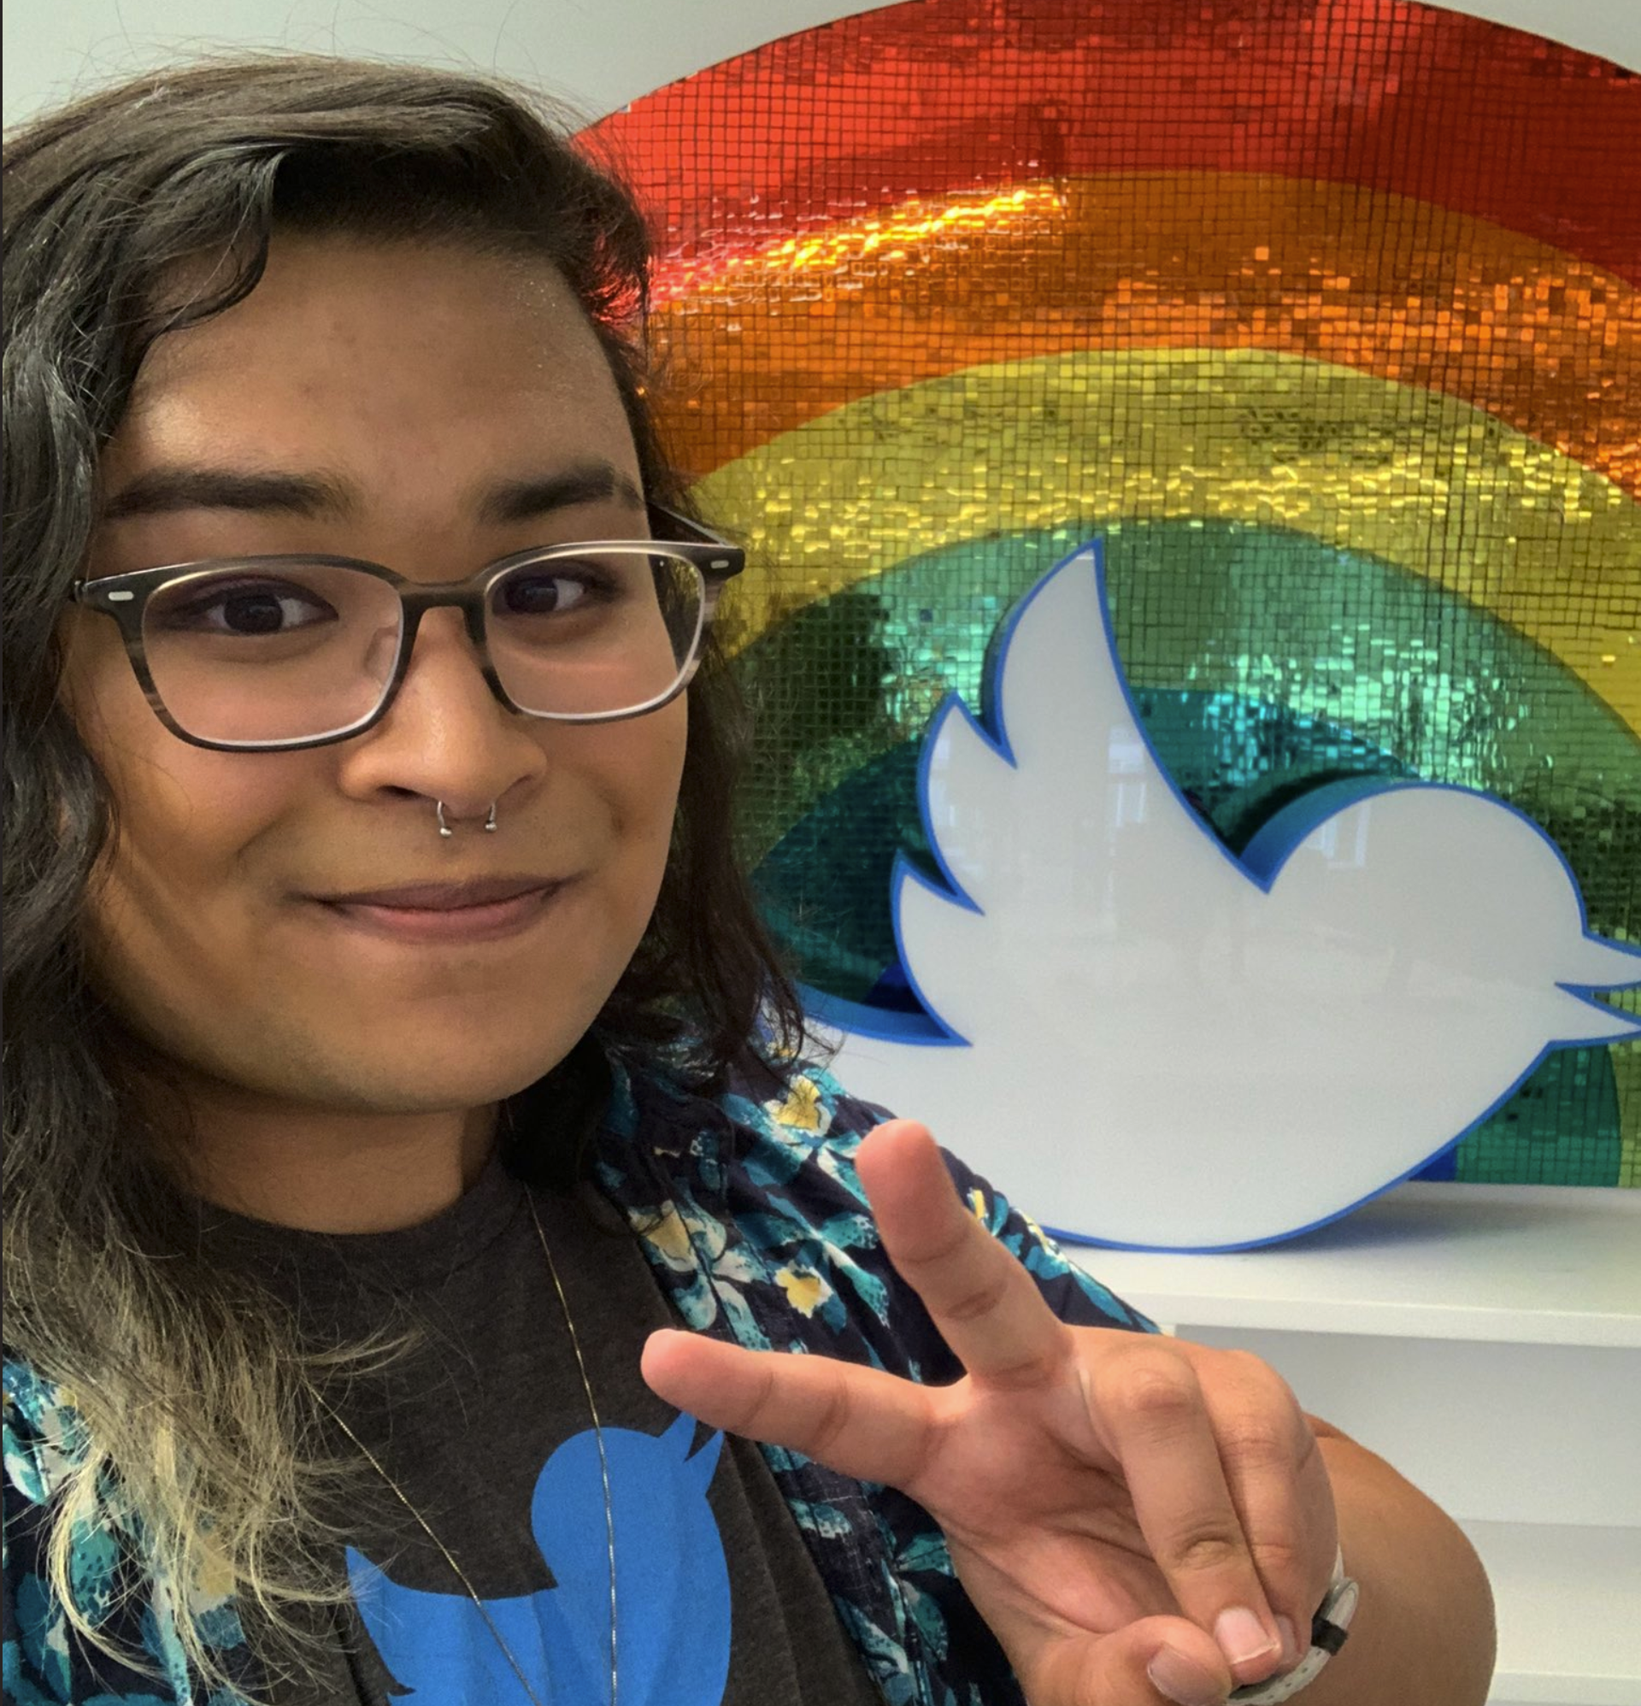
Movienight 101: How to
Power Video Streaming with Kubernetes and WebRTC
Rachel Sheikh
(She/Her)
Software Engineer @Twitter
@rachel_sheikh
Notes:
Hello hello! How is everyone doing today? I want to kick things off by thanking KubeCon and CloudNativeCon for having me here today in LA for my first conference talk! My name is Rachel Sheikh, and I’m a software engineer at Twitter, where I work on all of Twitter’s live audio and video services and products, including our newest offering Twitter Spaces, which is a conversational tool that allows users to communicate with each other in a setting very similar to a conference panel. Today, I’ll be talking about a little project I built last year called Movienight. Today’s talk is meant for all audiences, so I’ll be staying fairly high level. I’ll be going over what Movienight is, what WebRTC is, how I used WebRTC, how I used Kubernetes, and my core takeaways and learnings that you can learn from if you ever want to follow in my footsteps! So let’s go ahead and kick it off

Slide 3


What is Movienight?
enables distributed, real time
watch parties with friends and family
allows for new entries into the session
at any point during the stream
incorporates access controls for secure
sessions
Notes:
So what is Movienight? I really like movies and tv shows, and I especially like watching them with my friends and family. Last year at the start of quarantine however, it became difficult to continue doing so when we couldn’t see each other in person. And it’s always a hassle trying to watch things over a computer while trying to sync things up over a phone call so you can simulate in-person watching. This pain is what inspired Movienight. I wanted to create a solution where you could, as a host, start watching a video and have other people join into your viewing session to watch it together in near-real-time. This involves giving someone the driver seat over controlling where the watch party is at in the show, controlling who is allowed to access, and making sure the process is seamless enough that you can just start it on your laptops and leave it. Similar offerings in this space include the chrome extension, Netflix Party, or Disney Plus’ Groupwatch

Slide 4
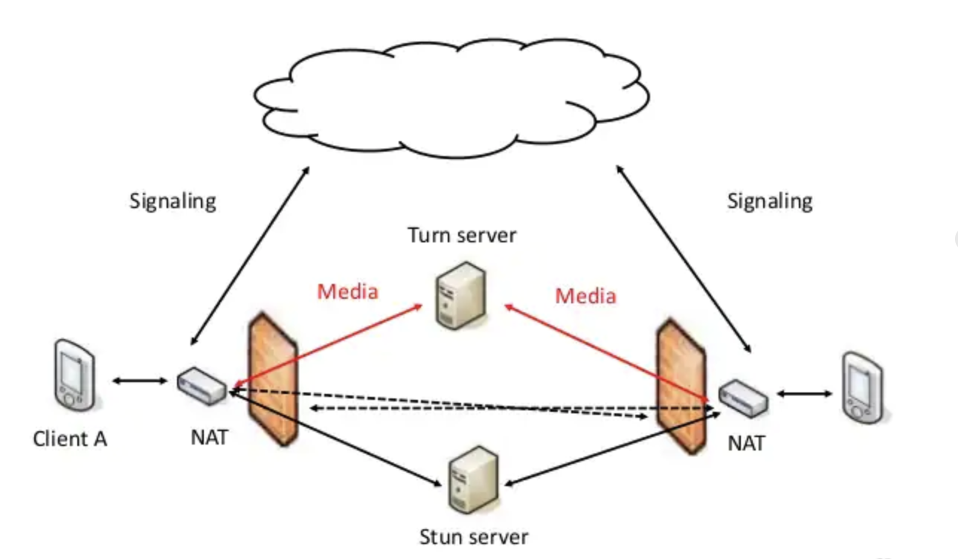
What is WebRTC?
open-source framework that enables peer-to-peer connections
Terminology:
Session Description Protocol (SDP) Offers and Answers
Signaling Server
Interactive Connectivity Establishment (ICE)
Session Traversal Utilities for NAT (STUN)
Traversal Using Relay around NAT (TURN)
Notes:
So let’s break down the core technology I used to build Movienight, WebRTC. WebRTC is an open-source framework, created by Google, that enables the creation of peer-to-peer connections for real-time data sharing. WebRTC has a few key terms that we can review before jumping into how I used it, so let’s break them down. The first being Session Description Protocol, or SDP, which holds a lot of metadata about your end of the session. This metadata can include your audio and video codecs, your ICE candidates, which we’ll get into in a second, and other key data points needed to maintain a connection between two peers. When the host starts a Movienight session, they create an SDP offer. When a viewer joins, they send an SDP answer. These are coordinated through the Signaling server, which handles the handshake between the peers within WebRTC.
However, firewalls are a thing, and your ip address is constantly changing, so this is where Interactive Connectivity Establishment, or ICE, comes into play. Each peer in the WebRTC environment generate their own list of ICE candidates, which are just public-facing IP/Port pairs that other peers can use to connect with them. WebRTC handles this process through the use of a STUN server, which goes through the lists of ICE candidates, and calculates the correct IP/Port pairs to use when establishing the peer-to-peer connections. For most small projects like Movienight, this was good enough. The STUN server makes the connection, and allows for the video data to flow between the connected ports via TCP. However, there are instances where STUN won’t be able to make a successful connection. This is where you would look to implement a TURN server, which have public addresses that all peers can connect to, and facilitate the streaming of video data via UDP or TCP.

Slide 5
The WebRTC Part
Create an API to facilitate connecting to a Signaling Server with RTCPeerConnection
Use a free Google STUN resource to connect Peers
Hook up an OBS stream into the Movienight session
Notes:
So why did I want to use WebRTC? First and foremost, Movienight was a side project, and we all use side projects to learn cool technologies, so that was an important part to me. But beyond that, WebRTC seemed like a really compelling tool for streaming out to a virtual room in real-time, which was what I was looking for when it comes to watching shows with people. There was also an avid WebRTC community to fall back on when I had questions about setting things up, so it was super easy to learn the ins and outs of the technology.
So let’s jump into how I built it. First, I created a simple webcam to webcam project. This helped me set up a signaling server in Firebase, where I could create the SDP offer and answer mechanism, with an RTCPeerConnection. This is how I created the initial handshake on my same system. Next, I set up a connection to a STUN server using one of Google’s free STUN resources. This opened up connecting between different peers across the network. After that, it was a simple change to switch from a bidirectional webcam capture to a window capture using OBS as a media stream. And that was it! I had a single session WebRTC-enabled streaming platform up and running, and I was able to put it to the test with a friend.

Slide 6
The Kubernetes Part
Place single-session logic into a Pod
Take advantage of horizontal load balancing with an auto-scaler
Enable instance recovery via auto-healing containers
Notes:
It’s one thing to build a single watch session, and it’s another to scale up and get more people on the platform to have their own movie nights. This is where Kubernetes came in. I’m at a Kubernetes conference today, so I’ll save the deep dive for one of the many other talks, but at a high level, Kubernetes was a great tool for automated scaling. It had great community support, thank you all, for learning the nuances of setting up the various components of kubernetes infra needed to deploy out a service. It also has fairly native support for auto-scaling and creating replicas of an instance up to a limit. The way movienight was set up, an instance was a watch session. So this form of replica-powered scaling was crucial for making this accessible to others. It also had Instance recovery through auto-healing. I was only able to get exposure to this last point through exploratory research, but in practice it sounds like it would have been really cool to implement at scale, since the SDP data on Firebase would keep track of the media timestamp for recoveries to land back where the instance died.

Slide 7
Tying it all together
Build out a single WebRTC instance to stream a single Movienight session, and add it to a container
Build out Kubernetes infra to house container code within a Pod
Deploy, scale, and watch away!
Notes:
So let’s recap on what I just went over. I started out building a single WebRTC instance to handle facilitating the peer to peer connection, making the networking handshake, and streaming the media. This was the start of Movienight. Then, I bundled it into a Kubernetes Pod and learned how to put together the infra to allow for Movienight to scale horizontally and accept new watch sessions. Finally, I deployed it out, invited people to join on, and watched it scale up to meet the need!

Slide 8
Learnings and Takeaways
Explore a different video streaming protocol/approach
Explore opportunities with bundled P2P/Video stream
Play around with different approaches to initial scaling

Slide 9


Q & A
@Rachel_Sheikh

